Slide 1
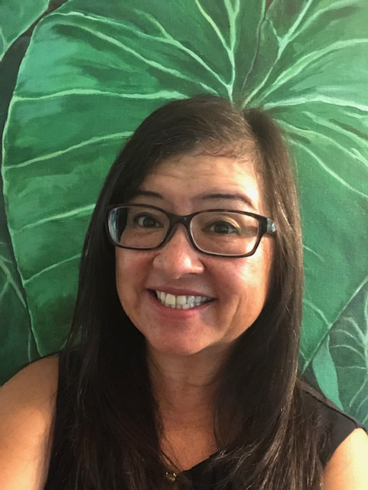
Lianne Casupang
Sexual Assault Response Coordinator
Services I Provide:
I ensure that appropriate care is coordinated and provided to victims of sexual assault. I track the services provided to a victim of sexual assault from the initial report through final disposition and resolution. I coordinate all training, prevention and response efforts throughout District 14 AOR. I also administer the Victim Advocate program.
Trainings I Provide:
SAPRR program trainings: CG Bystander Intervention Training, general all-hands SAPRR training (giving/receiving consent, impact of sexual assault, recovery from sexual assault, male victimization, retaliation, offender behavior)
Work-Life balance trainings: resiliency, mindfulness, operational stress control, stress management, anger management, conflict management, group dynamics, giving/receiving feedback, communication in the workplace, etc.
Licensure and Certification:
Licensed mental health counselor in the State of Hawaii
National certified counselor
Professional Milestones:
Bachelor’s Degree in Secondary Education
Master’s Degree in Counseling Psychology
D14 AOR Sexual Assault Response Coordinator
400 Sand Island Pkwy
Honolulu, HI 96819
lianne.m.casupang@uscg.mil
(808) 842-2087 (office)
(808) 291-7720 (cell)

Slide 2
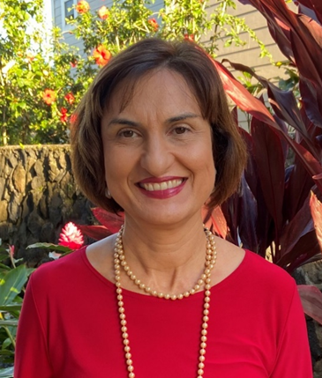
Graziella Panetta, MBA, ChFC®, AFC® (Graziella)
Personal Financial Manager
Services I provide: I oversee the Personal Financial Management Program for District 14, primarily providing training and assistance to Command Financial Specialists. In addition, I provide financial education, financial counseling and resources and referrals to Coast Guard members and their families.
Professional Milestones: (advancement, SWE, Promotion, RELAD/EoE):
Master in Business Administration
Accredited Financial Counselor Designation
Chartered Financial Consultant Designation
Current Assignment:
D14 Personal Financial Manager
400 Sand Island Pkwy
Honolulu, HI 96819
Graziella.panetta@uscg.mil
(808)842-2751(office)
(808)291-3154(cell)
Qualifications: MBA,ChFC®,AFC®

Slide 3
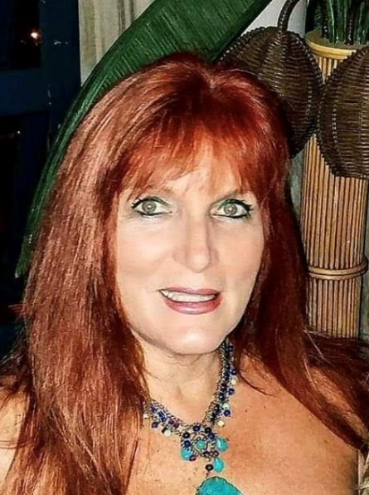
(Mary) Katherine Robredo
Family Advocacy Specialist
Services I provide: I serve to help reduce and prevent family violence within the Coast Guard by promoting healthy family life via relevant information, resources, and referrals.
I provide guidance to Command and Individuals on Domestic Violence and Child Abuse Issues.
I provide individual, couples and family counseling.
I offer a variety of Individual, Marriage and Family Enrichment classes to include PREP: Fighting for Your Marriage, Step-Family Classes, Parenting Classes, Seven Habits of Highly Effective Military Families and Marriage classes, Stress Management and several other topic. Please call me and see what I can offer your unit!
Current Assignment:
Family Advocacy Specialist
400 Sand Island Pkwy
Honolulu, HI
Mary.K.Robredo@USCG.mil
(808)842-2770(office)
(808)798-0461(cell)
Qualifications: Master of Social Work, U of Washington, 1981
LCSW- Colorado 1998-present

Slide 4
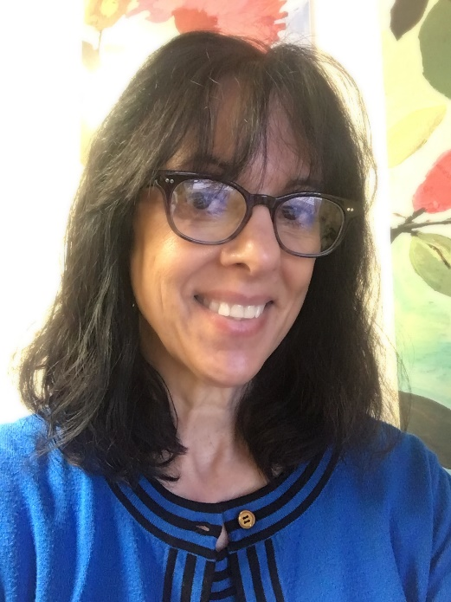
Tiffani Collier
(Tiffani)
Employee Assistance Program Coordinator
Temporarily covering D14 during our EAPC vacancy
Service I provide: I serve as the point of contact for all employee assistance issues. I provide prevention training, response, and support services to those impacted by critical/traumatic incidents, workplace violence threat, and suicidal behaviors. I oversee the CG-SUPRT contract and ensure that you are able to access counseling (and I manage
Current Assignment:
D14 Acting EAP Coordinator
D11 EAP Coordinator
Base Los Angeles Long Beach
1001 S Seaside Avenue
San Pedro, CA 90731
Tiffani.collier@uscg.mil
(310) 521-6136 (office)
(310) 877-3779 (cell)
TEAMS Address:
Tiffani.s.collier.civ@cvr.mil
Qualifications:
MA in Leadership and Development
BS in Organizational Psychology
Certified Instructor: CISM

Slide 5
Jessica Dung (Jessica or Jess)
Transition Relocation Manager
Ombudsman Program Coordinator
Legacy Health Promotion Manager
Services I provide: I facilitate access to a full range of relocation services, including transition out of the Coast Guard, spouse employment assistance, and sponsorship. I also oversee the Ombudsman program for District 14, providing training, resources, and assistance to Ombudsmen and their commands.
Current Assignment:
Base Honolulu HSWL
400 Sand Island Pkwy
Honolulu, HI 96819
jessica.r.dung@uscg.mil
(808) 842-2088 (office)
(808) 419-4728 (cell)

Slide 6
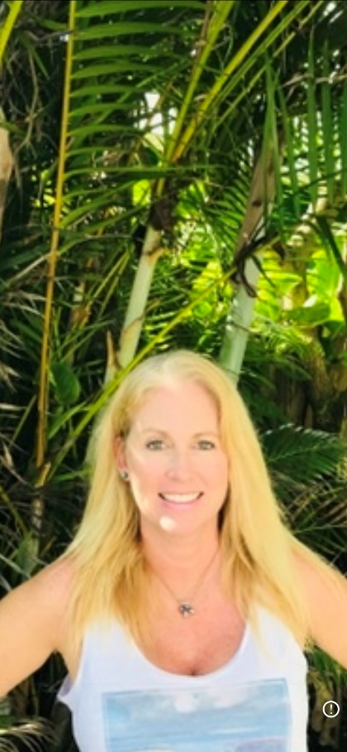
Stacey Sawyer
Family Resource Specialist
Services I provide: I provide assistance with Special Needs program enrollment, updates, and information and referral services for child care, elder care, school issues, scholarships, and adoption.
Current Assignment:
Family Resource Specialist
Base Honolulu, D14
400 Sand Island Pkwy
Honolulu, HI. 96813
Office:(808) 842-2089
Fax: (808)842-2098
Cell: (808) 688-7052
Qualifications: BA (Psychology), Masters Healthcare Administration
.

Slide 7
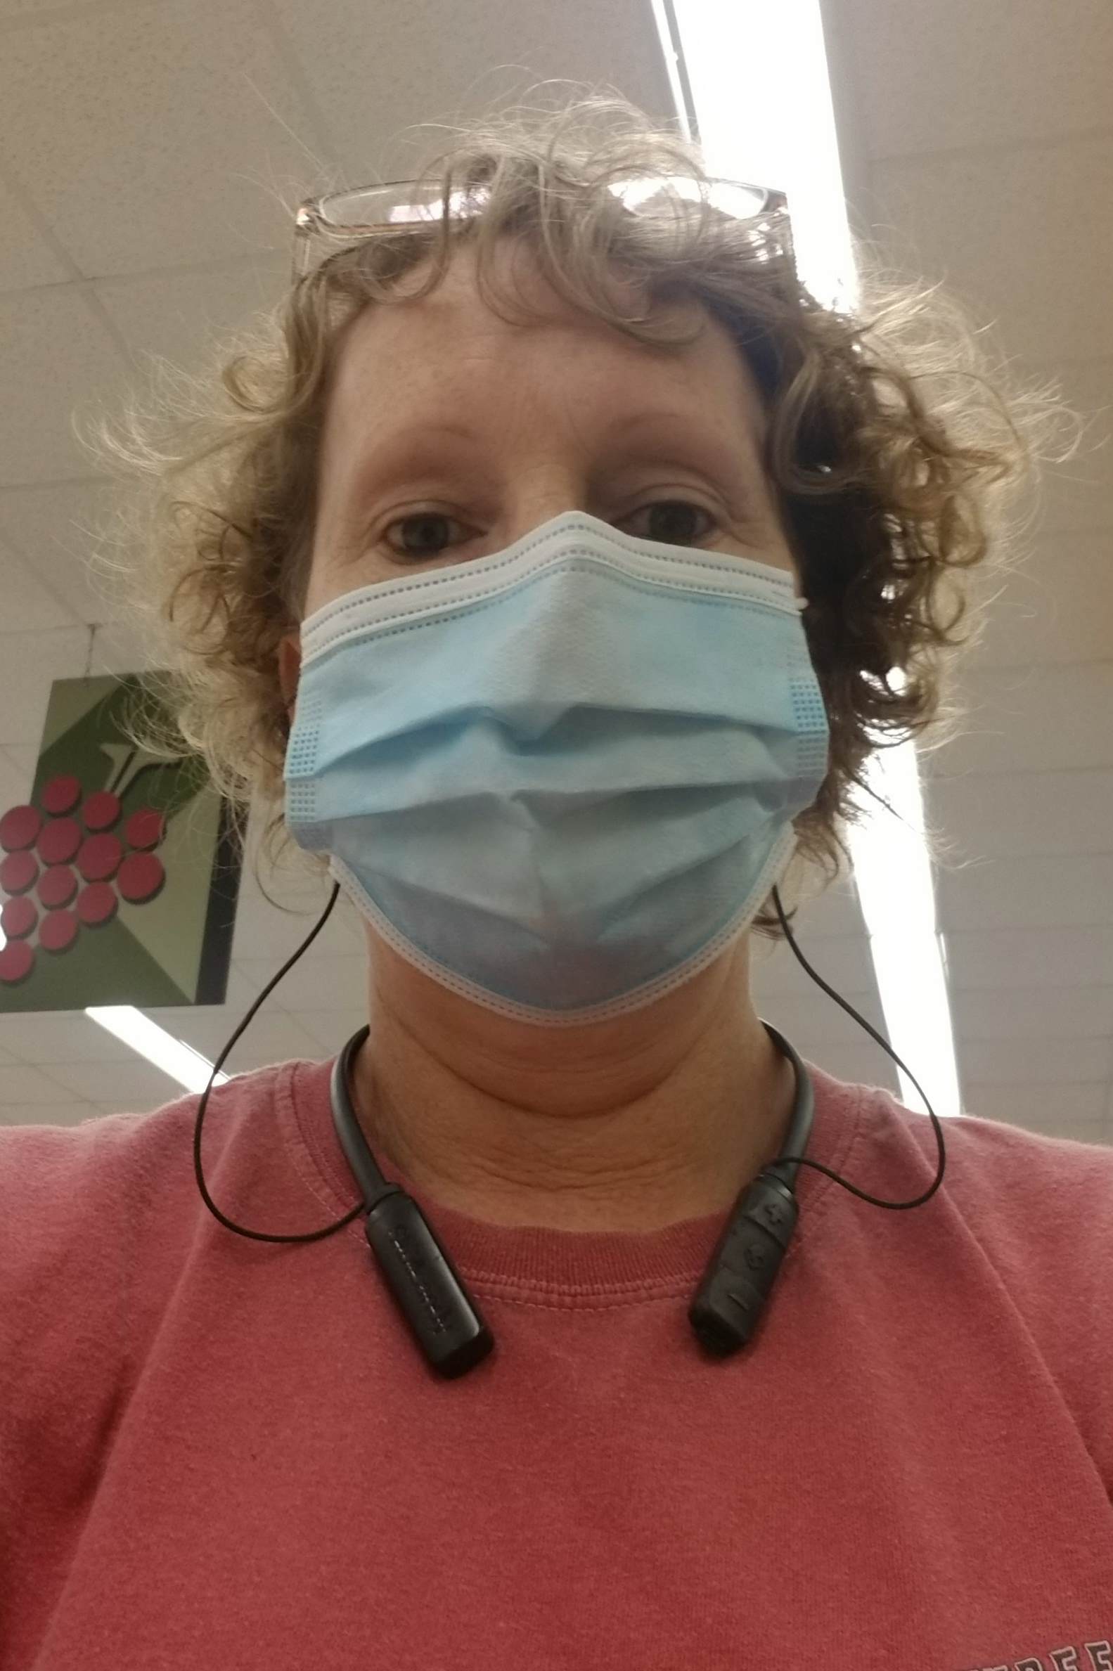
Deana Farquharson
Services I provide: Administrative, budgetary, editorial, and technical support for the D14 Regional Practice.
Current Assignment:
Secretary
USCG Base Honolulu HSWL
400 Sand Island Pkwy
Honolulu, HI 96819
julee.d.farquharson@uscg.mil
(808) 842-2085 (office)

Slide 8
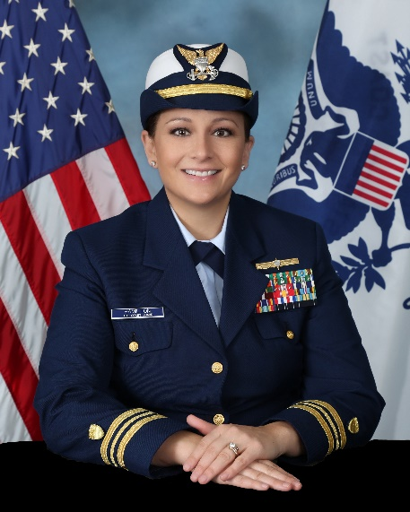
LCDR Jessica Hamilton
D14 Regional Practice Manager
Base Honolulu HSWL Department Head
Work-Life Supervisor
Qualifications:
Bachelor of Science in Business Administration, Management (Hawaii Pacific University)
Master of Health Administration (Baylor University)
Master of Business Administration (Baylor University)
Current Assignment:
Base Honolulu HSWL Dept Head
D14 Regional Practice Manager
Work-Life Supervisor
400 Sand Island Pkwy
Honolulu, HI 96819
jessica.e.hamilton@uscg.mil
(808) 842-2086 (office)

